Slide 1
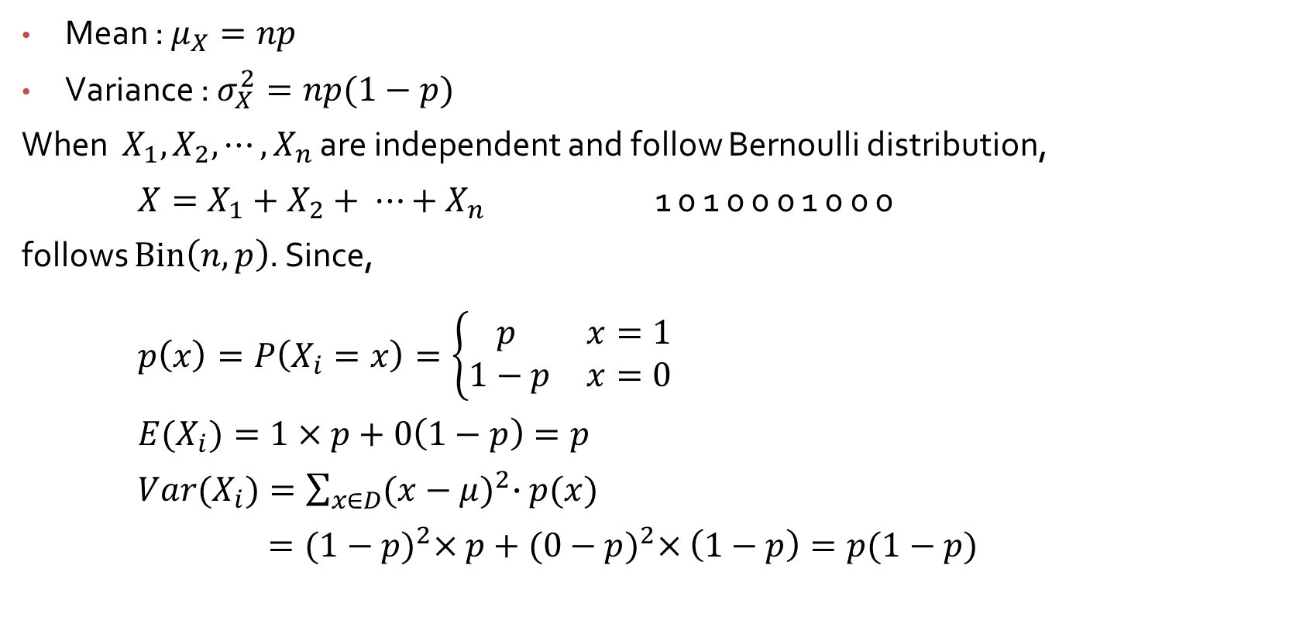
Binomial R.V. Mean and Variance
Mean : $μ_{X}=np$
Variance : $σ_{X}^{2}=np(1−p)$
When $X_{1}, X_{2}, ⋯,X_{n}$ are independent and follow Bernoulli distribution,
$X=X_{1}+X_{2}+ ⋯+X_{n}$ 1 0 1 0 0 0 1 0 0 0
follows $Bin\left(n, p\right)$. Since,
$p\left(x\right)=P\left(X_{i}=x\right)=\left\{\begin{matrix}p & x=1 \\ 1−p & x=0\end{matrix}\right.$
${E(X}_{i})=1×p+0\left(1−p\right)=p$
${Var(X}_{i})=\sum_{x∈D}{{(x−μ)}^{2}∙p(x)}$
$={(1−p)}^{2}×p+{(0−p)}^{2}×\left(1−p\right)=p(1−p)$

Slide 2
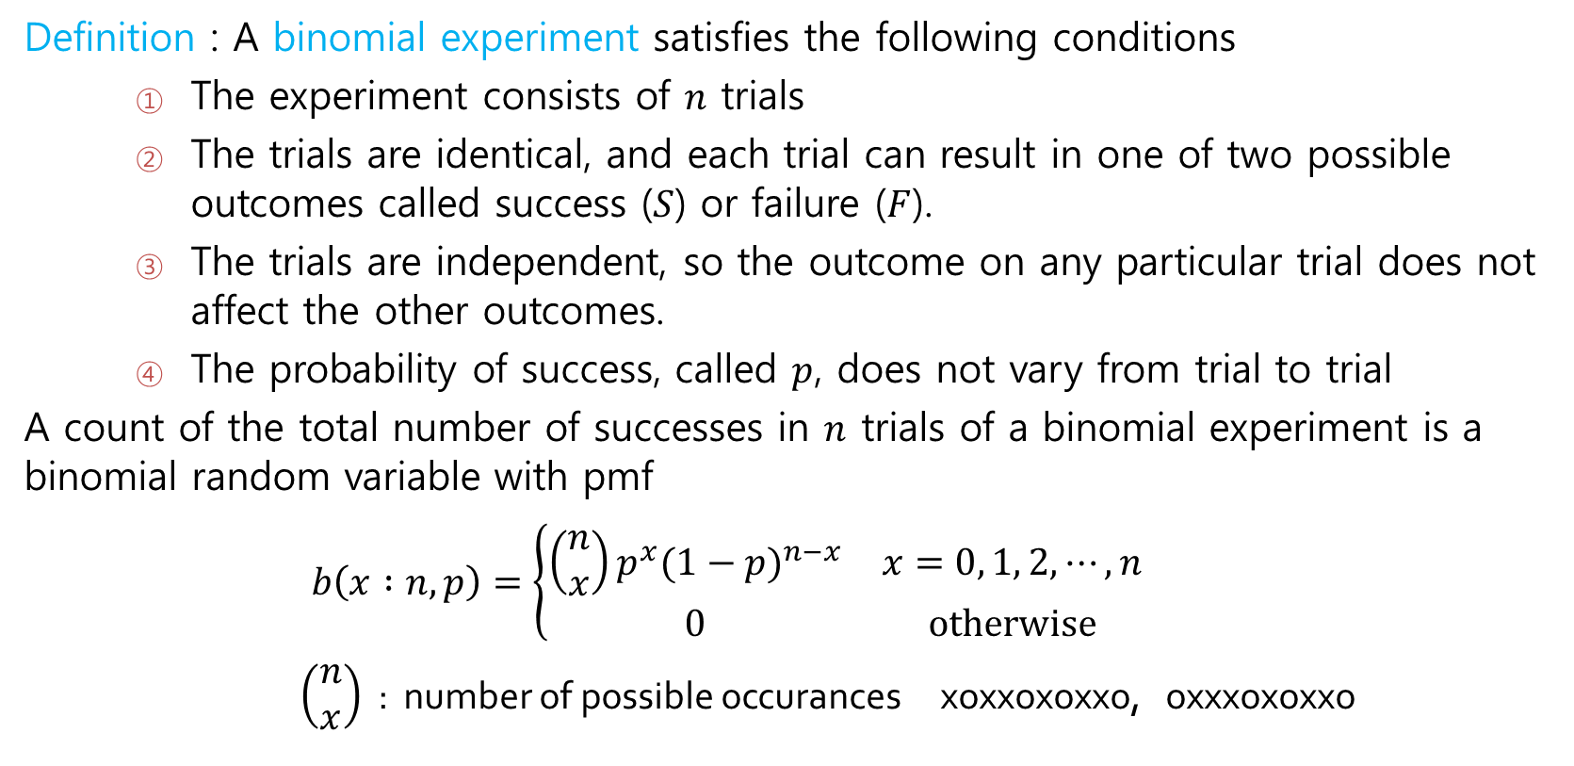
Binomial Probability Distribution
Definition : A binomial experiment satisfies the following conditions
The experiment consists of $n$ trials
The trials are identical, and each trial can result in one of two possible outcomes called success ($S$) or failure ($F$).
The trials are independent, so the outcome on any particular trial does not affect the other outcomes.
The probability of success, called $p$, does not vary from trial to trial
A count of the total number of successes in $n$ trials of a binomial experiment is a binomial random variable with pmf
$$b\left(x :n, p\right)=\left\{\begin{matrix}{\left(\begin{matrix}n \\ x\end{matrix}\right)p^{x}(1−p)}^{n−x} & x=0, 1, 2, ⋯, n \\ 0 & otherwise\end{matrix}\right.$$
$\left(\begin{matrix}n \\ x\end{matrix}\right)$ : number of possible occurances xoxxoxoxxo, oxxxoxoxxo

Slide 3
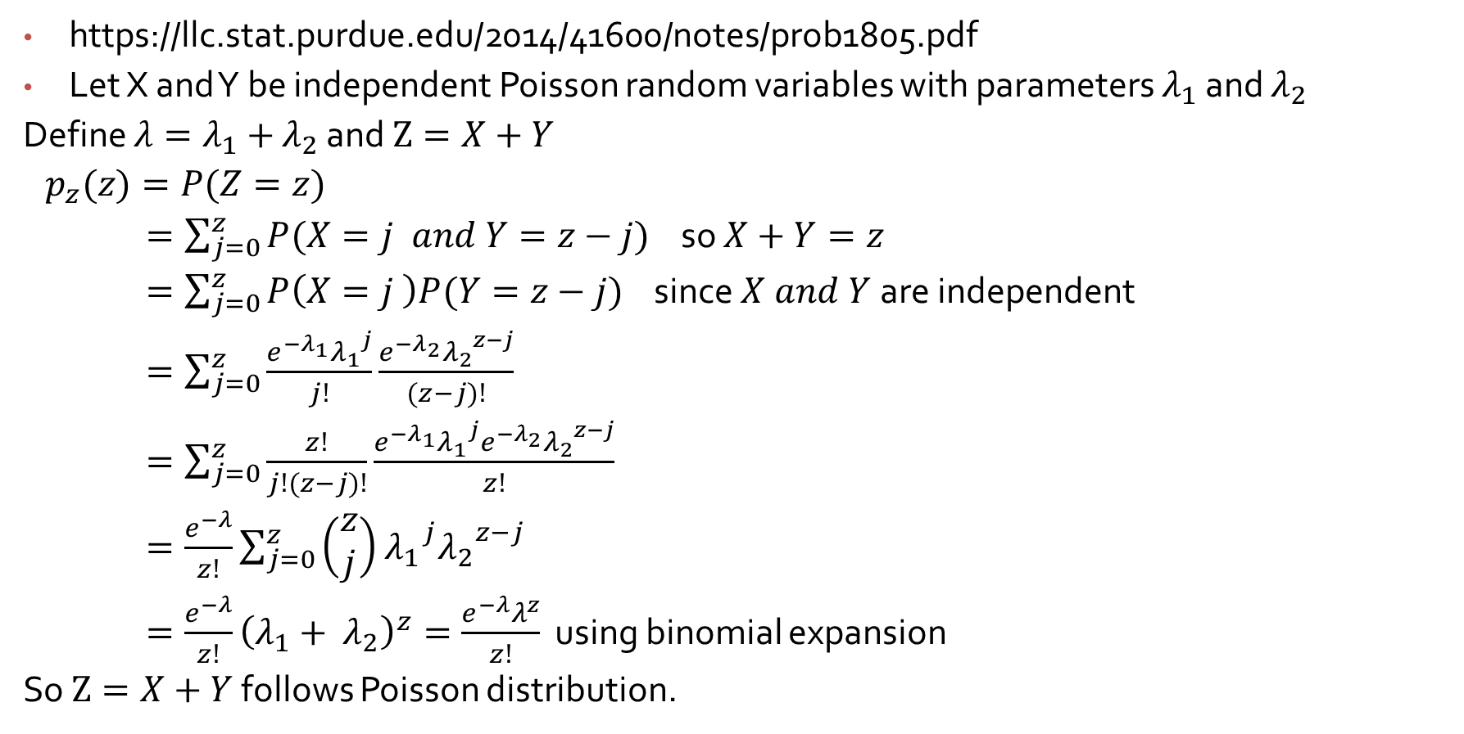
Sums of independent Poisson random variables
https://llc.stat.purdue.edu/2014/41600/notes/prob1805.pdf
Let X and Y be independent Poisson random variables with parameters $λ_{1}$ and $λ_{2}$
Define ${λ=λ}_{1}+$ $λ_{2}$ and $Z=X+Y$
$p_{z}(z)=P(Z=z)$
$=\sum_{j=0}^{z}{P(X=j and Y=z−j)}$ so $X+Y=z$
$=\sum_{j=0}^{z}{P\left(X=j \right)P(Y=z−j)}$ since $X and Y$are independent
$=\sum_{j=0}^{z}{\frac{e^{−λ_{1}}{λ_{1}}^{j}}{j!}\frac{e^{−λ_{2}}{λ_{2}}^{z−j}}{(z−j)!}}$
$=\sum_{j=0}^{z}{\frac{z!}{j!(z−j)!}\frac{e^{−λ_{1}}{λ_{1}}^{j}e^{−λ_{2}}{λ_{2}}^{z−j}}{z!}}$
$=\frac{e^{−λ}}{z!}\sum_{j=0}^{z}{\left(\begin{matrix}z \\ j\end{matrix}\right)}$ ${λ_{1}}^{j}{λ_{2}}^{z−j}$
$=\frac{e^{−λ}}{z!}{\left(λ_{1}+ λ_{2}\right)}^{z}=\frac{e^{−λ}λ^{z}}{z!}$ using binomial expansion
So $Z=X+Y$ follows Poisson distribution.

Slide 4
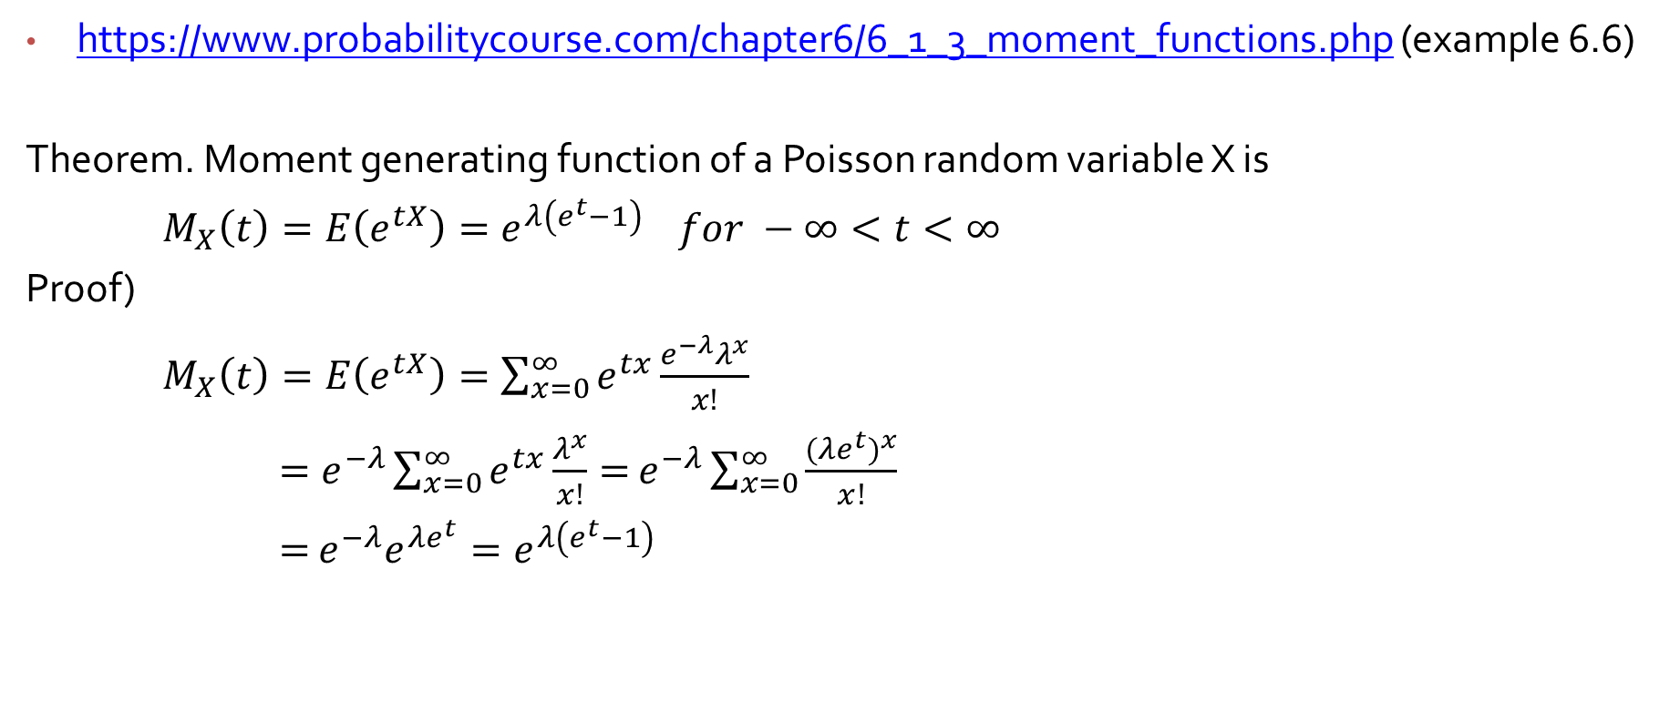
Moment generating function of independent Poisson random variables**
https://www.probabilitycourse.com/chapter6/6_1_3_moment_functions.php (example 6.6)
Theorem. Moment generating function of a Poisson random variable X is
$M_{X}\left(t\right)=E\left(e^{tX}\right)=e^{λ\left(e^{t}−1\right) } for −∞<t<∞$
Proof)
$M_{X}\left(t\right)=E\left(e^{tX}\right)=\sum_{x=0}^{∞}{e^{tx}}\frac{e^{−λ}λ^{x}}{x!}$
$=e^{−λ}\sum_{x=0}^{∞}{e^{tx}}\frac{λ^{x}}{x!}=$ $e^{−λ}\sum_{x=0}^{∞}{\frac{{(λe^{t})}^{x}}{x!}}$
$=$ $e^{−λ}e^{λe^{t}}=e^{λ\left(e^{t}−1\right) }$

Slide 5
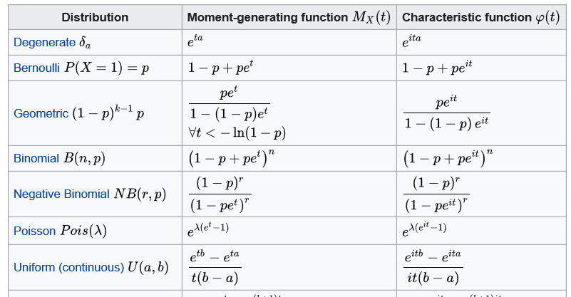
https://en.wikipedia.org/wiki/Moment-generating_function**

Slide 6
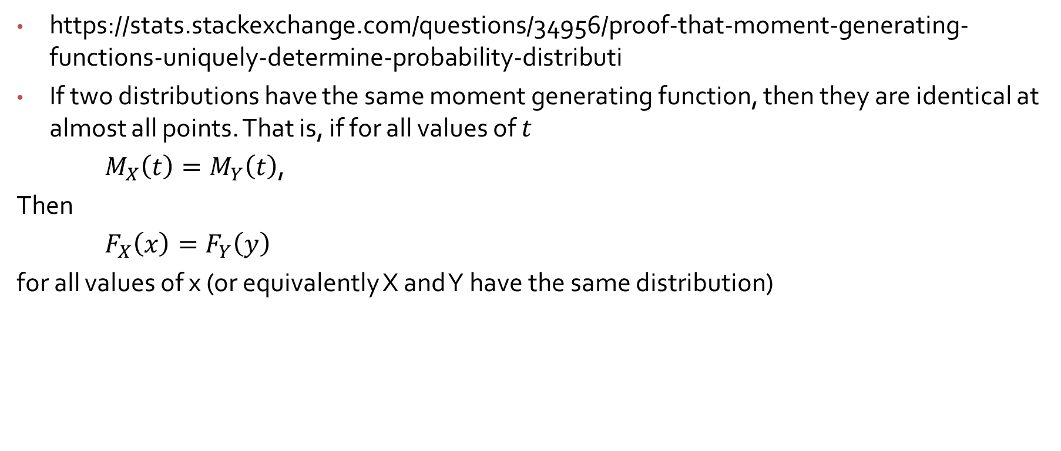
Important Properties of moment generating function**
https://stats.stackexchange.com/questions/34956/proof-that-moment-generating-functions-uniquely-determine-probability-distributi
If two distributions have the same moment generating function, then they are identical at almost all points. That is, if for all values of $t$
$M_{X}\left(t\right)=M_{Y}\left(t\right)$,
Then
$F_{X}\left(x\right)=F_{Y}\left(y\right)$
for all values of x (or equivalently X and Y have the same distribution)

Slide 7
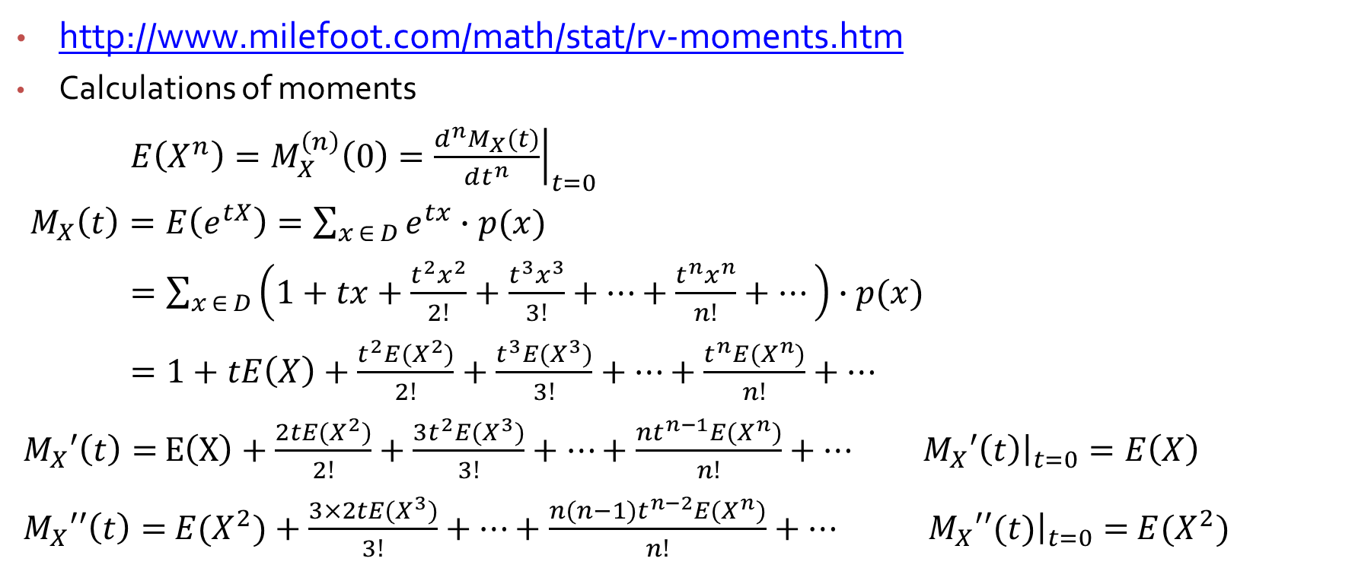
Important Properties of moment generating function**
http://www.milefoot.com/math/stat/rv-moments.htm
Calculations of moments
$E\left(X^{n}\right)=M_{X}^{\left(n\right)}\left(0\right)={\left.\frac{d^{n}M_{X}(t)}{dt^{n}}\right|}_{t=0}$
$M_{X}\left(t\right)=E\left(e^{tX}\right)=\sum_{x ∈ D}{e^{tx}∙p(x)}$
$=\sum_{x ∈ D}{\left(1+tx+\frac{{t^{2}x}^{2}}{2!}+\frac{{t^{3}x}^{3}}{3!}+⋯+\frac{{t^{n}x}^{n}}{n!}+⋯\right)∙p(x)}$
$=1+tE\left(X\right)+\frac{{t^{2}E(X}^{2})}{2!}+\frac{{t^{3}E(X}^{3})}{3!}+⋯+\frac{{t^{n}E(X}^{n})}{n!}+⋯$
$M_{X}′\left(t\right)=$ $E\left(X\right)+\frac{{2tE(X}^{2})}{2!}+\frac{{{3t}^{2}E(X}^{3})}{3!}+⋯+\frac{{{nt}^{n−1}E(X}^{n})}{n!}+⋯$ ${\left.M_{X}′\left(t\right)\right|}_{t=0}=E\left(X\right)$
$M_{X}′′\left(t\right)={ E(X}^{2})+\frac{{3×2tE(X}^{3})}{3!}+⋯+\frac{{{n(n−1)t}^{n−2}E(X}^{n})}{n!}+⋯$ ${\left.M_{X}′′(t)\right|}_{t=0}={ E(X}^{2})$

Slide 8
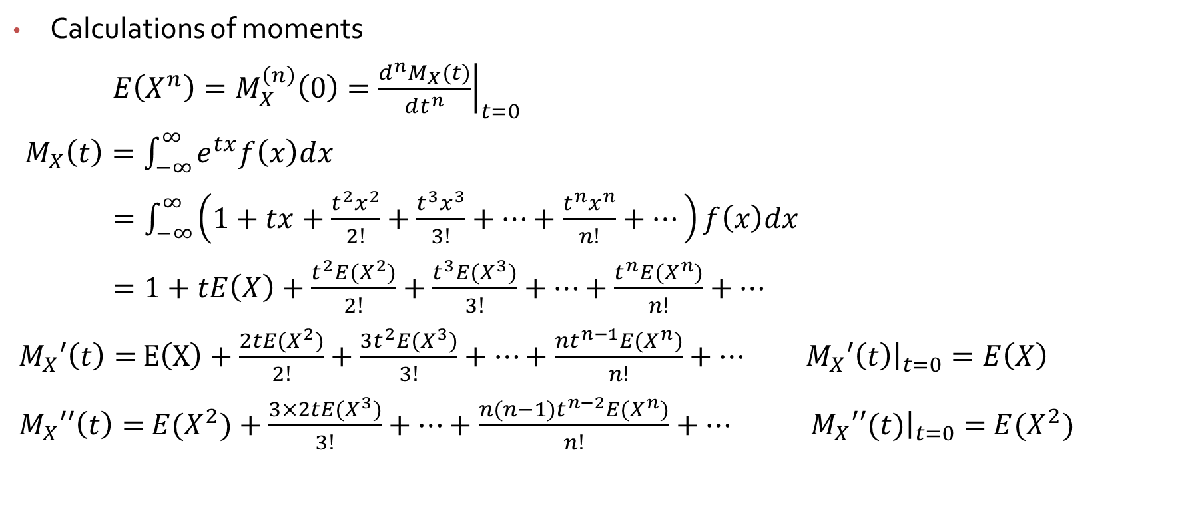
Important Properties of moment generating function**
Calculations of moments
$E\left(X^{n}\right)=M_{X}^{\left(n\right)}\left(0\right)={\left.\frac{d^{n}M_{X}(t)}{dt^{n}}\right|}_{t=0}$
$M_{X}\left(t\right)=\int_{−∞}^{∞}{e^{tx}f\left(x\right)dx}$
$=\int_{−∞}^{∞}{\left(1+tx+\frac{{t^{2}x}^{2}}{2!}+\frac{{t^{3}x}^{3}}{3!}+⋯+\frac{{t^{n}x}^{n}}{n!}+⋯\right)f\left(x\right)dx}$
$=1+tE\left(X\right)+\frac{{t^{2}E(X}^{2})}{2!}+\frac{{t^{3}E(X}^{3})}{3!}+⋯+\frac{{t^{n}E(X}^{n})}{n!}+⋯$
$M_{X}′\left(t\right)=$ $E\left(X\right)+\frac{{2tE(X}^{2})}{2!}+\frac{{{3t}^{2}E(X}^{3})}{3!}+⋯+\frac{{{nt}^{n−1}E(X}^{n})}{n!}+⋯$ ${\left.M_{X}′\left(t\right)\right|}_{t=0}=E\left(X\right)$
$M_{X}′′\left(t\right)={ E(X}^{2})+\frac{{3×2tE(X}^{3})}{3!}+⋯+\frac{{{n(n−1)t}^{n−2}E(X}^{n})}{n!}+⋯$ ${\left.M_{X}′′(t)\right|}_{t=0}={ E(X}^{2})$

Slide 9
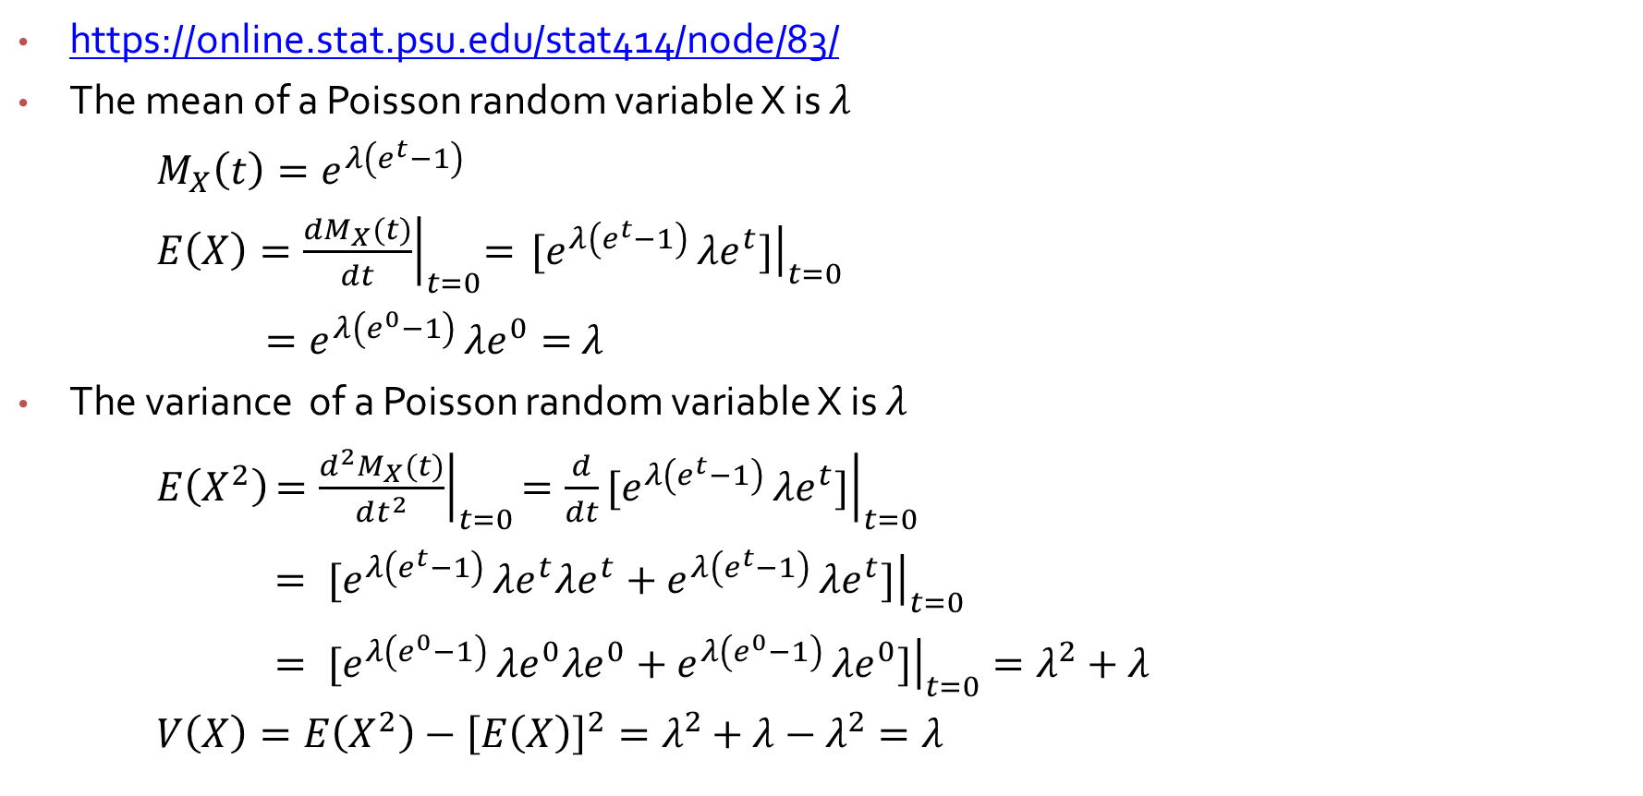
Mean and variance of Poisson distribution**
https://online.stat.psu.edu/stat414/node/83/
The mean of a Poisson random variable X is $λ$
$M_{X}\left(t\right)=e^{λ\left(e^{t}−1\right) }$
$E\left(X\right){=\left.\frac{dM_{X}(t)}{dt}\right|}_{t=0}=$ ${\left.{[e}^{λ\left(e^{t}−1\right) }λe^{t}]\right|}_{t=0}$
$=e^{λ\left(e^{0}−1\right) }λe^{0}=$ $λ$
The variance of a Poisson random variable X is $λ$
$E\left(X^{2}\right){\left.=\frac{d^{2}M_{X}(t)}{dt^{2}}\right|}_{t=0}{\left.={\frac{d}{dt}[e}^{λ\left(e^{t}−1\right) }λe^{t}]\right|}_{t=0}$
${\left.={ [e}^{λ\left(e^{t}−1\right) }λe^{t}λe^{t}+e^{λ\left(e^{t}−1\right) }λe^{t}]\right|}_{t=0}$
${\left.={ [e}^{λ\left(e^{0}−1\right) }λe^{0}λe^{0}+e^{λ\left(e^{0}−1\right) }λe^{0}]\right|}_{t=0}=λ^{2}+λ$
$V\left(X\right)=E\left(X^{2}\right)−{\left[E\left(X\right)\right]}^{2}=λ^{2}+λ−λ^{2}=λ$

Slide 10

Sums of independent random variables**
Let $X_{1}, X_{2},$ …${, X}_{n}$ are $n$independent random variables, and the random variable $Y$ is defined as
$Y={X_{1}+X}_{2}+$ $⋯{+X}_{n}$
Then
$M_{Y}\left(t\right)=E\left[e^{t({X_{1}+X}_{2}+ ⋯{+X}_{n})}\right]$
$=E\left[e^{tX_{1}}e^{tX_{2}}⋯e^{tX_{n}}\right]$
$=E\left[e^{tX_{1}}\right]E\left[e^{tX_{2}}\right]⋯E\left[e^{tX_{n}}\right]$
$=M_{X_{1}}\left(t\right)M_{X_{2}}\left(t\right)⋯M_{X_{n}}\left(t\right)$

Slide 11
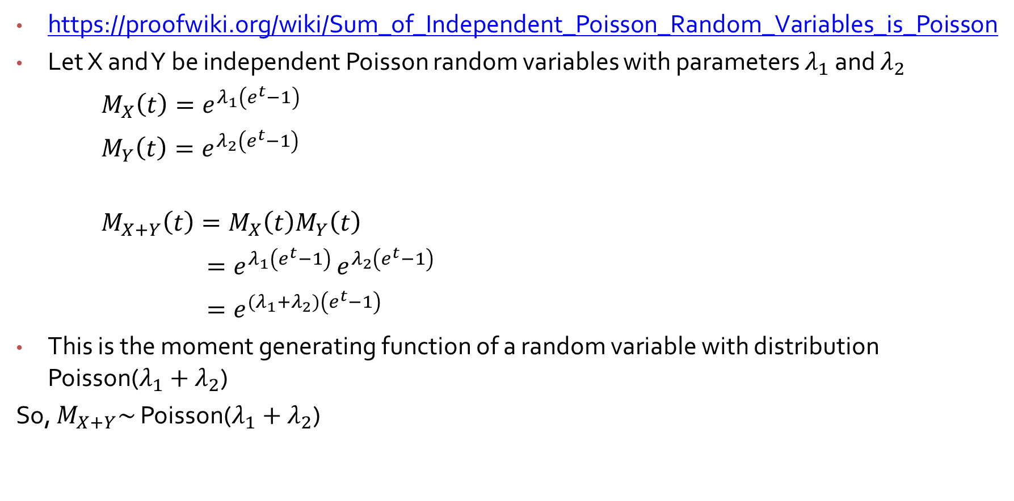
Sums of independent Poisson random variables**
https://proofwiki.org/wiki/Sum_of_Independent_Poisson_Random_Variables_is_Poisson
Let X and Y be independent Poisson random variables with parameters $λ_{1}$ and $λ_{2}$
$M_{X}\left(t\right)=e^{λ_{1}\left(e^{t}−1\right) }$
$M_{Y}\left(t\right)=e^{λ_{2}\left(e^{t}−1\right) }$
$M_{X+Y}\left(t\right)=M_{X}\left(t\right)M_{Y}\left(t\right)$
$=e^{λ_{1}\left(e^{t}−1\right) }e^{λ_{2}\left(e^{t}−1\right) }$
$=e^{(λ_{1}+λ_{2})\left(e^{t}−1\right) }$
This is the moment generating function of a random variable with distribution Poisson($λ_{1}+λ_{2}$)
So, $M_{X+Y}\sim$ Poisson($λ_{1}+λ_{2}$)

